Slide 1

TECHNOLOGY & RESEARCH TRENDS
Dr. Achmad Solichin, S.Kom., M.T.I
TOP 10
Artificial
Intelligence
2021
IN

Slide 2
artificial intelligence
“the designing and building of intelligent agents that receive percepts from the environment and take actions that affect that environment”
Russel & Norvig, 2016 “Artificial Intelligence: A Modern Approach”

Slide 3
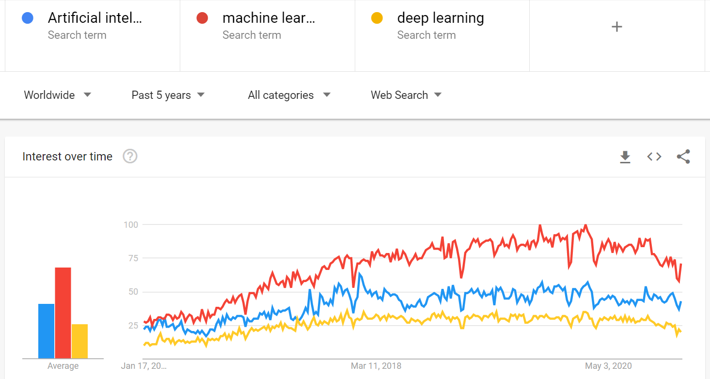
Google Trends, 2021

Slide 4
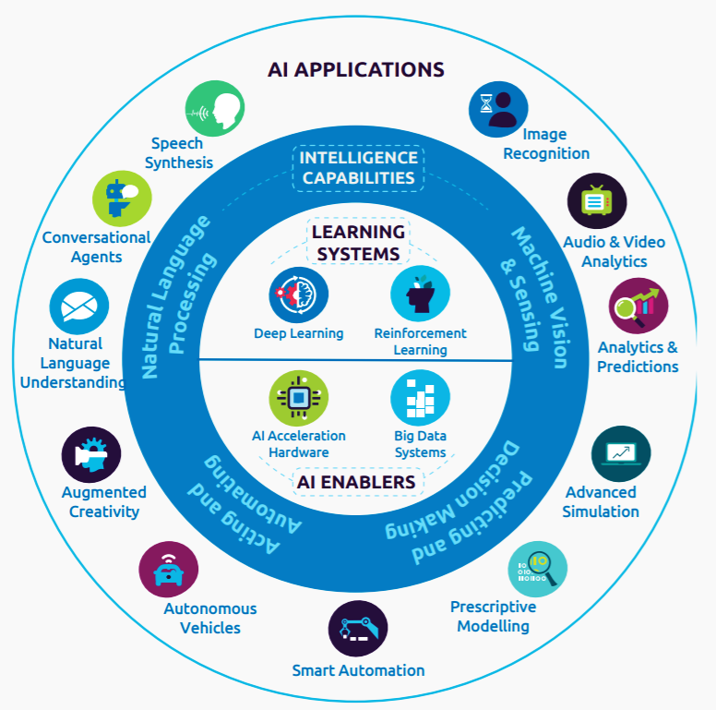
AI Taxonomy
Source: Capgemini Technology, Innovation & Ventures
Notes:
Capgemini Technology, Innovation & Ventures

Slide 5
#1
Robotic Process Automation (RPA) is a technology that allows anyone to configure computer software, or a “robot” to emulate and integrate the actions of a human interacting within digital systems to execute a business process.
Robotic Process Automation
Notes:
https://www.abeam.com/id/en/service_line/RPA

Slide 6
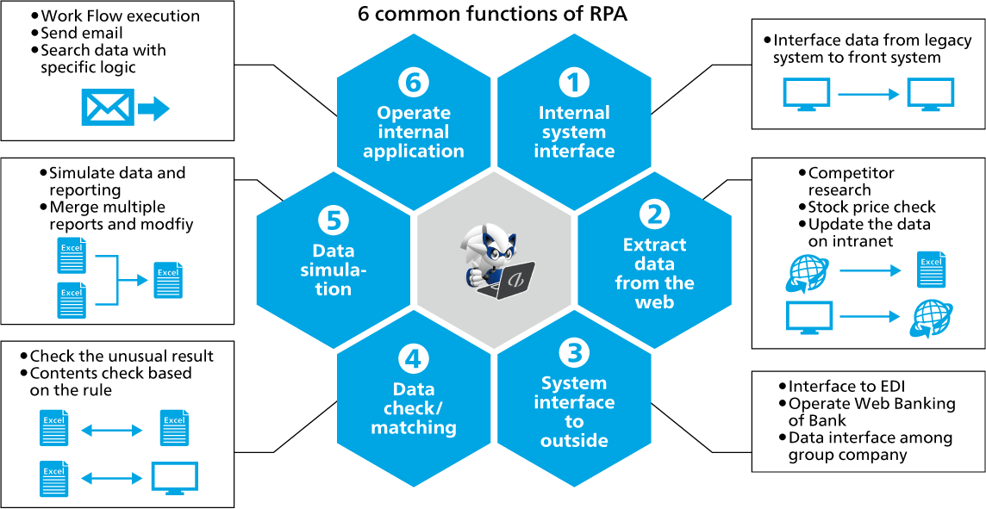
Notes:
Sumber: https://www.abeam.com/id/en/service_line/RPA

Slide 7
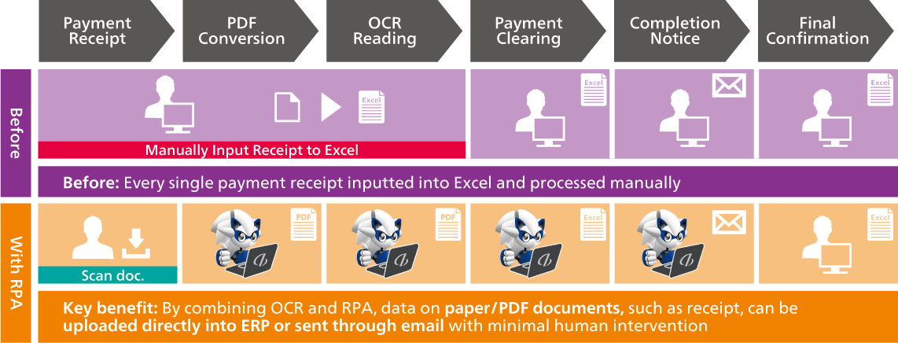
Before and After Using RPA
Notes:
Sumber: https://www.abeam.com/id/en/service_line/RPA

Slide 8
#2
What is Smart Health?
Provision of health-related services using a network of context-aware intelligent agents.
SMART HEALTH
Notes:
https://www.abeam.com/id/en/service_line/RPA

Slide 9
AI in Healthcare Systems
Today’s healthcare systems have recognized the advantages of smart technology that can improve healthcare quality, thereby turning traditional technologies into smart health care.
Smart medical technology can define better monitors, diagnostic tools for patient treatment, and devices to improve the quality of life.
Key smart health concepts include eHealth and mHealth services, electronic record management, smart home medical services, and connected smart medical devices using the latest IoT (internet of things) and wearable computing technologies

Slide 10
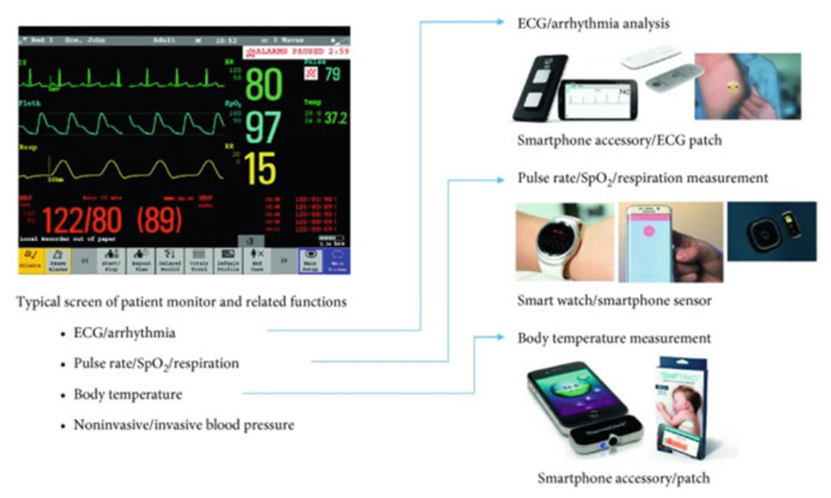
Patient monitoring system for wearable devices (Cho, 2019)

Slide 11

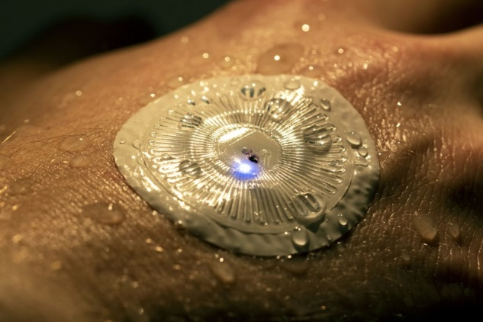
ADAMM : Intelligent Asthma Management
A small, flexible, device that uses medical grade adhesives to adhere to the user's upper torso. Wirelessly monitors respiratory symptoms, and transfers data via bluetooth the the users' device.
Wearable Flexible Sensors (WFS)
A wearable sweat-sensing device mounted on the back of the hand transmits perspiration data and skin temperature back to a smartphone.(John Rogers Research Group)
Notes:
https://www.latimes.com/science/sciencenow/la-sci-sn-wearable-sweat-sensor-20190128-story.html

Slide 12
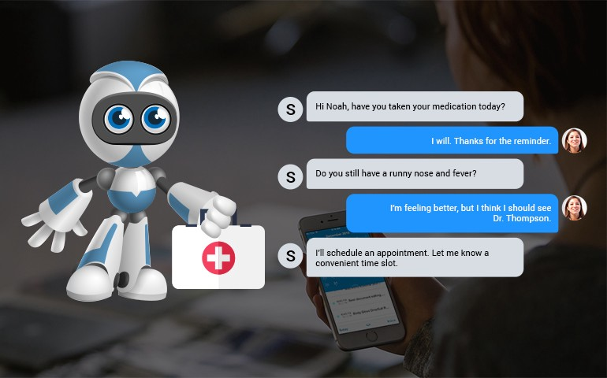
Health Chatbot
OneRemission
Youper
Safedrugbot
Babylon Health
Florence
GYANT
etc

Slide 13
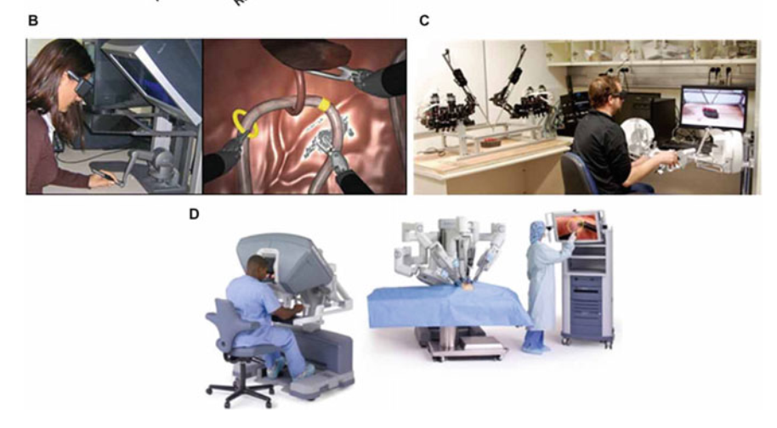
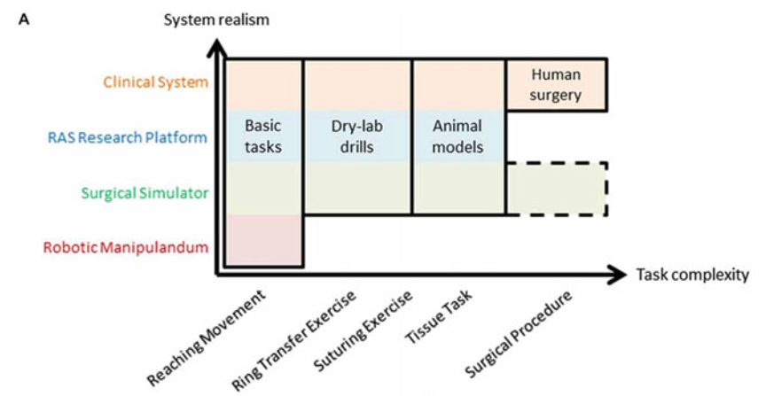
Robot-Assisted Surgery (RAS) Technology
(Jarc and Nisky, 2015)
Notes:
https://www.ncbi.nlm.nih.gov/pmc/articles/PMC4455232/

Slide 14
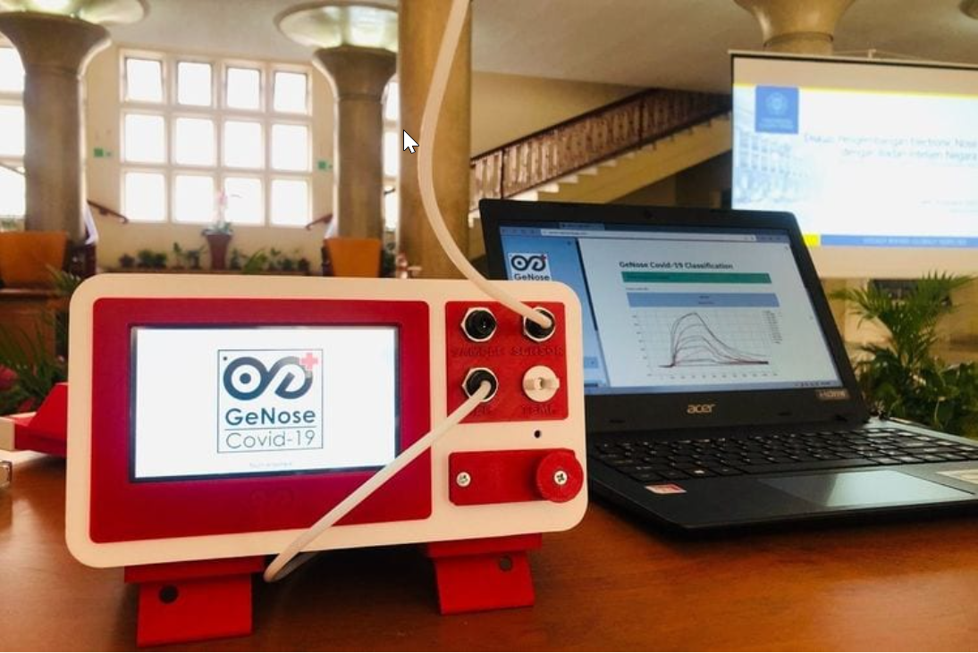
GeNose: AI-based Detection for Covid-19
GeNose identifies the corona virus by detecting Volatile Organic Compound (VOC).
It does not detect the virus directly. What they detect are gas metabolites when a person is infected with the virus
The composition of the gas in the human breath can also distinguish one disease from another. To track this composition, the UGM team uses artificial intelligence (AI) because it has to check thousands of gas compositions.
Notes:
Source: https://www.kompas.com/tren/read/2020/12/26/192900765/cara-kerja-genose-alat-deteksi-covid-19-buatan-ugm-yang-dapat-izin-edar

Slide 15
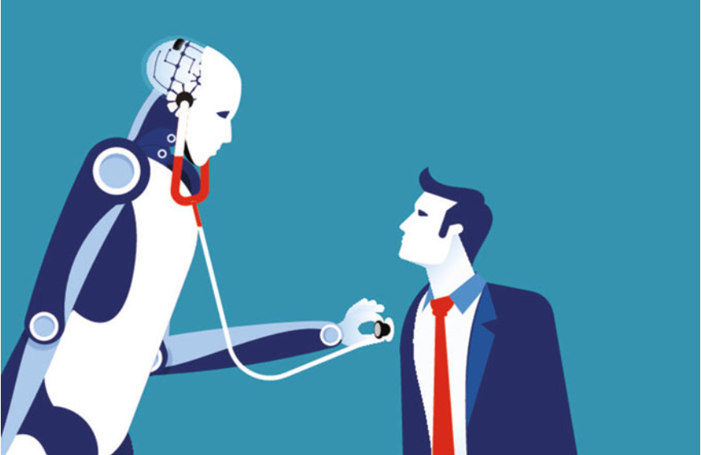
So, can AI replace a real doctor?
QUIZ #1

Slide 16
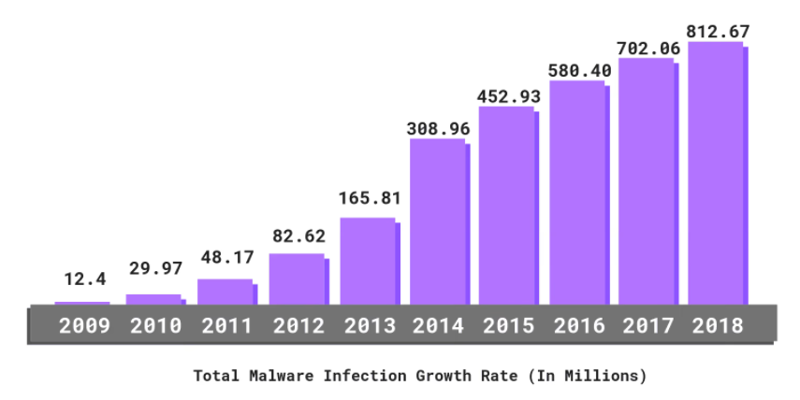
#3
Cybercrime Up 600% Due To COVID-19 Pandemic
AI for Cybersecurity & Data Breaches

Slide 17
AI for Cybersecurity & Data Breaches
In 2021 and beyond, digital data will be at more risk to be hacked and vulnerable to phishing attacks.
AI and advanced technologies will provide support to the security department against malicious activities in every field.
AI will help to prevent cybercrimes in future with enhanced enterprise cybersecurity measures.
The AI-supported system will spot fake digital activity or transactions that follow criminal patterns.

Slide 18
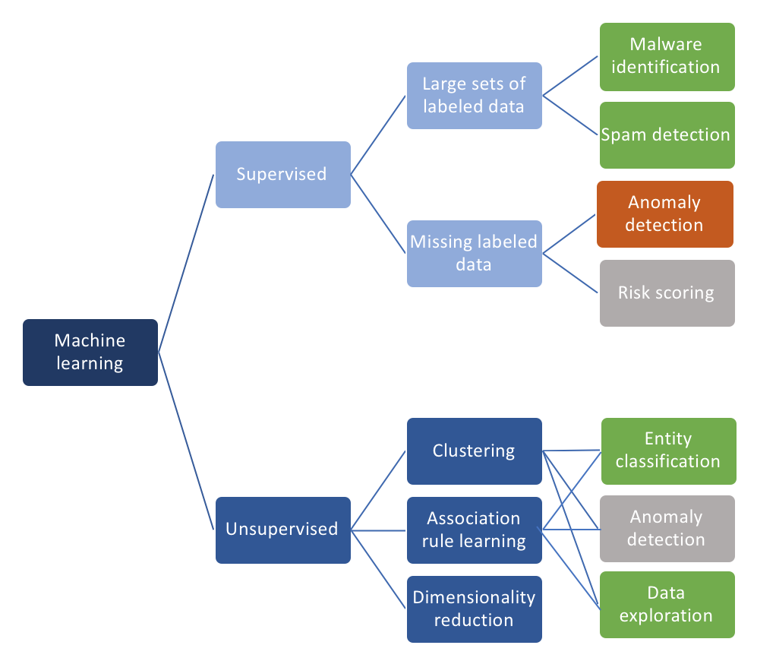
Machine Learning in Cybersecurity
Notes:
https://towardsdatascience.com/ai-and-machine-learning-in-cyber-security-d6fbee480af0

Slide 19
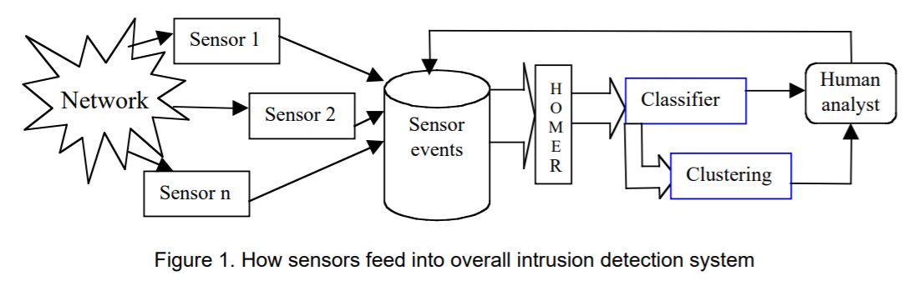
Data mining processes in MITRE’s intrusion detection system
Notes:
https://www.mitre.org/sites/default/files/pdf/bloedorn_datamining.pdf

Slide 20
#4
What is Natural language processing (NLP)?
Subfield of linguistics, computer science, and artificial intelligence concerned with the interactions between computers and human language, in particular how to program computers to process and analyze large amounts of natural language data.
NATURAL LANGUAGE PROCESSING
Notes:
https://www.abeam.com/id/en/service_line/RPA

Slide 21
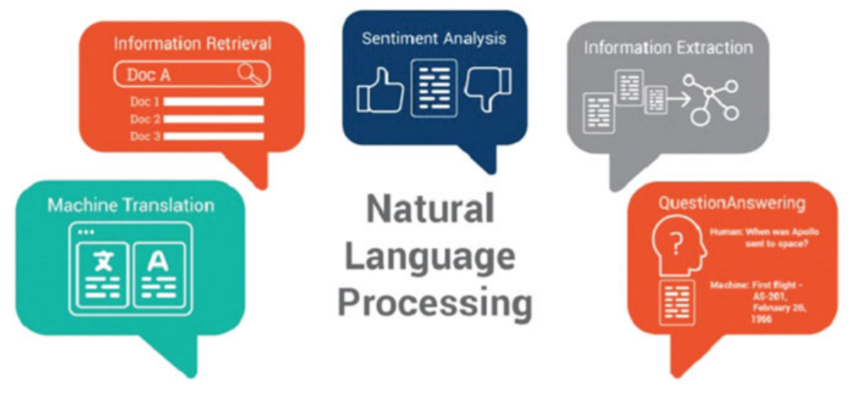
Natural Language Processing (NLP)
Natural Language Understanding ← → Natural Language Generation

Slide 22

Understanding the process of building an NLP Pipeline
Notes:
https://helloyubo.com/how-does-nlp-work-a-detailed-guide-to-make-an-nlp-pipeline/

Slide 23
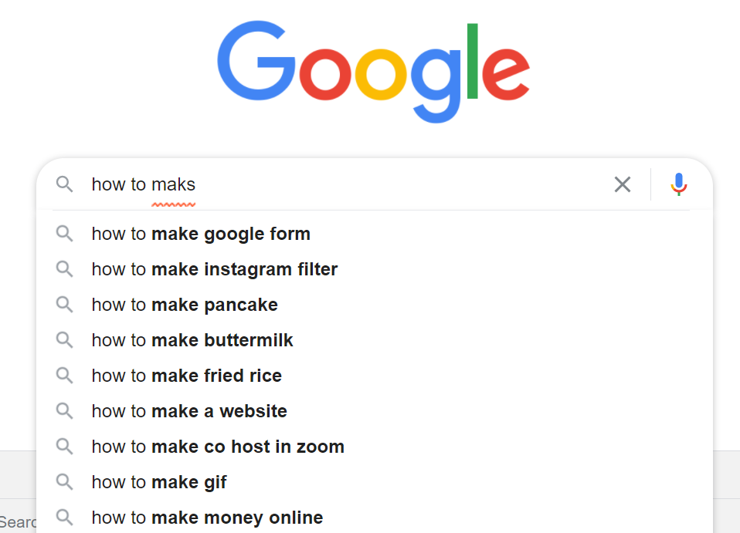
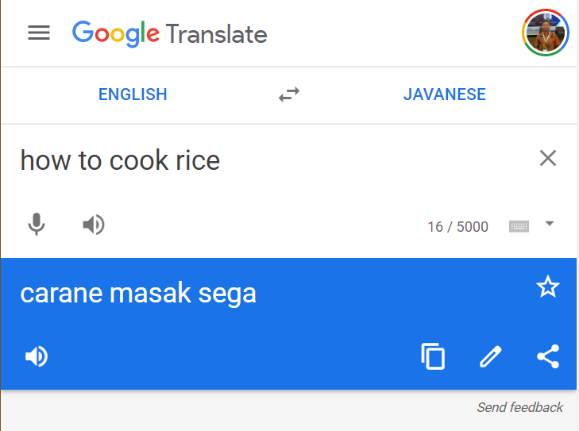

Slide 24

One day, will AI be able to understand animal language? Your opinion?
QUIZ #2

Slide 25
#5
What is Reinforcement Learning?
Reinforcement learning (RL) is an area of machine learning concerned with how intelligent agents ought to take actions in an environment in order to maximize the notion of cumulative reward.
REINFORCEMENT LEARNING
Notes:
https://www.abeam.com/id/en/service_line/RPA

Slide 26
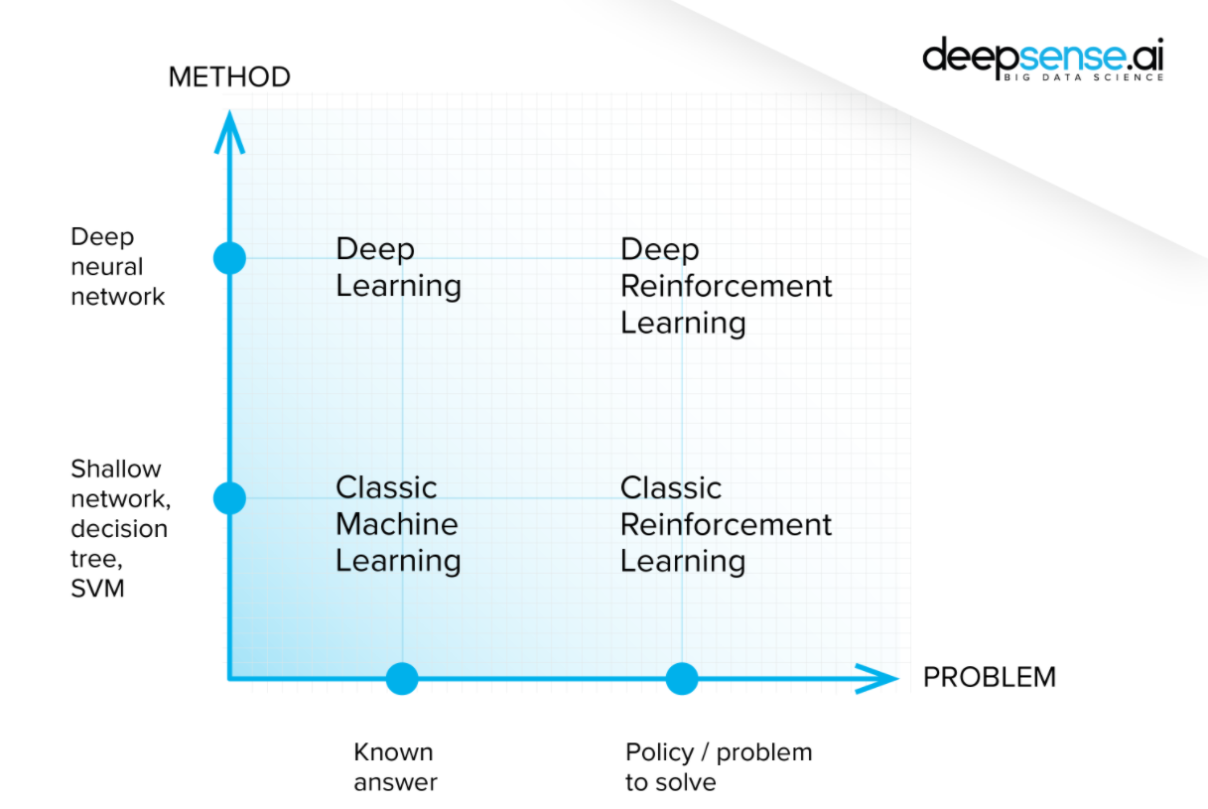
Reinforcement Learning

Slide 27



Reinforcement Learning: Breakout Game
Initial performance
After 15 minutes of training
After 30 minutes of training
Notes:
https://deepsense.ai/what-is-reinforcement-learning-the-complete-guide/

Slide 28
#6
What is Smart City?
A smart city is a place with the integration of latest 5G, Internet-of-Things (IoT), and AI technology, where networks and services are more flexible, efficient, and sustainable with the use of information, digital, and telecommunication technologies to improve operations and provide an entirely new horizon of living and working environment for its inhabitants.
SMART CITY

Slide 29
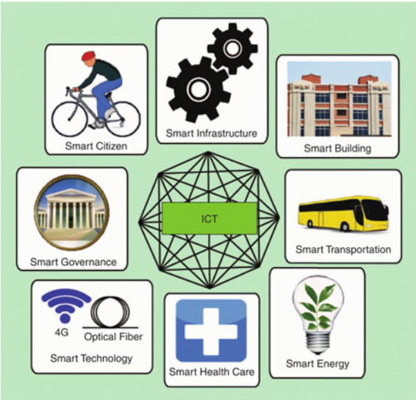
#6
SMART CITY
The IoT is the technical backbone of smart cities

Slide 30
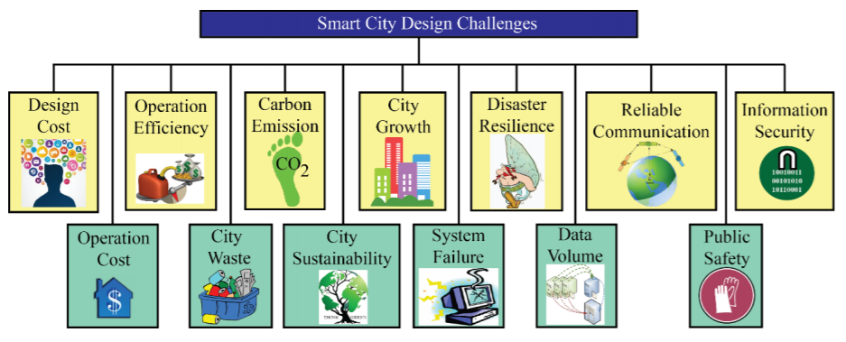
Smart City Design Challenges

Slide 31
#7
What is Smart Education?
Intelligent education is a term describing education and learning in the new AI era and the digital age which has attracted the attention of many researchers.
The goal of smart education (and smart learning ) is to train smart learners by adopting the latest IT, communication, and AI technologies to meet the work and life needs of the twenty-first century.
SMART EDUCATION

Slide 32
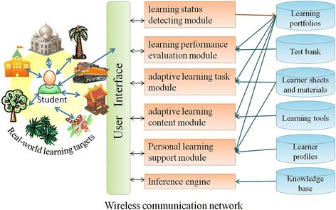
Smart Education Framework
Framework of a smart learning environment (Hwang, 2014)
Notes:
https://link.springer.com/article/10.1186/s40561-014-0004-5

Slide 33
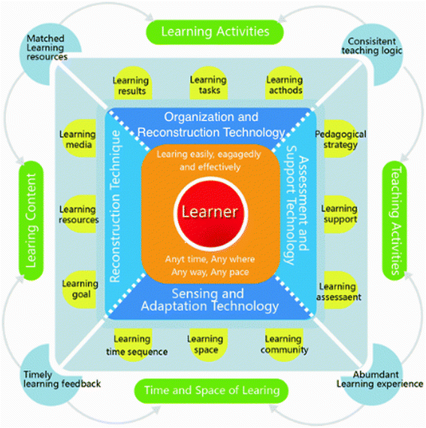
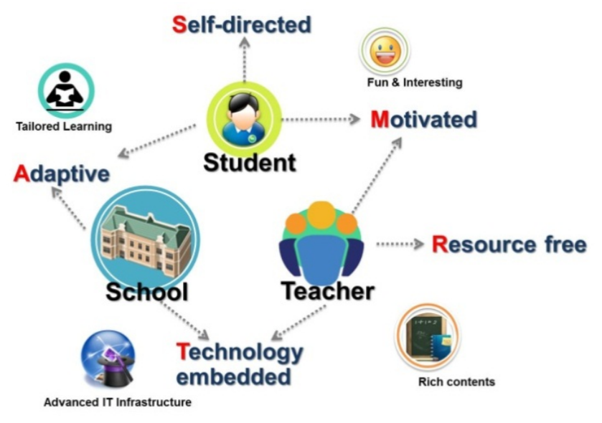
Smart Education Framework
Smart education proposed by Kim et al. (2013)
Framework of smart learning (Liu et al., 2017)
Notes:
https://link.springer.com/chapter/10.1007/978-3-642-37285-8_18
https://link.springer.com/article/10.1186/s40561-018-0052-3#Abs1

Slide 34
How is the implementation of a smart campus in Indonesia? Is there any?
QUIZ #3

Slide 35
Touchless Technology
A ‘no-touch touchscreen’ developed for use in cars could also have widespread applications in a post-COVID-19 world, by reducing the risk of transmission of pathogens on surfaces (Sarah Collins, University of Cambridge)
As a result of COVID-19, customers are increasingly looking for digital, no-touch connections with organizations, given the constraints and concerns about physical interactions in a new-normal, socially distanced world. (Capgemini Research Institute)
#8
TOUCHLESS TECHNOLOGY
Notes:
https://www.cam.ac.uk/research/news/ai-based-no-touch-touchscreen-could-reduce-risk-of-pathogen-spread-from-surfaces
https://www.capgemini.com/wp-content/uploads/2020/07/AI-in-CX_CRI-Report_16072020_V4.pdf

Slide 36
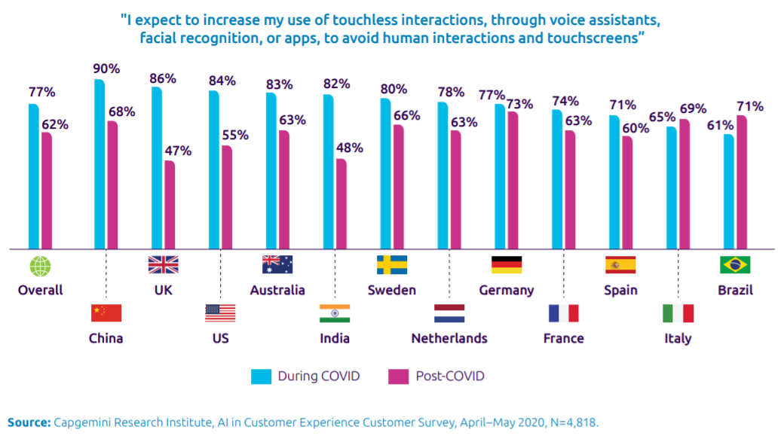
Notes:
https://www.capgemini.com/wp-content/uploads/2020/07/AI-in-CX_CRI-Report_16072020_V4.pdf

Slide 37
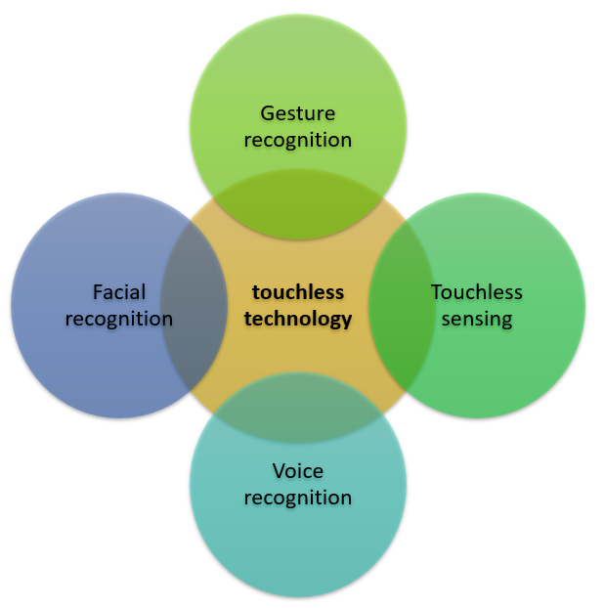
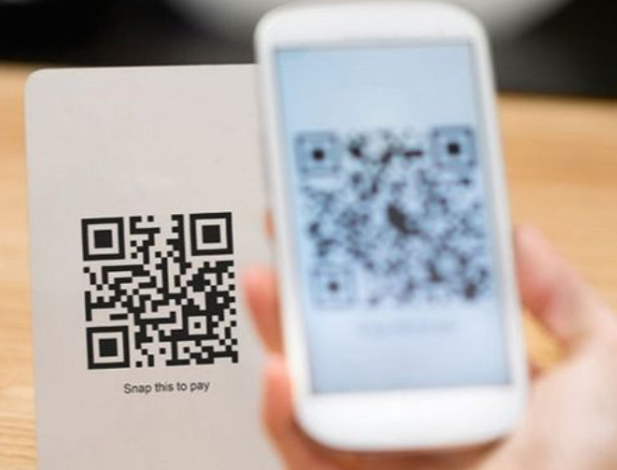
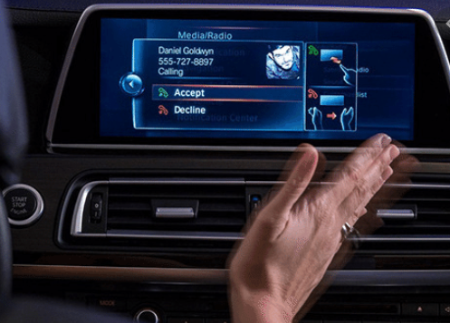
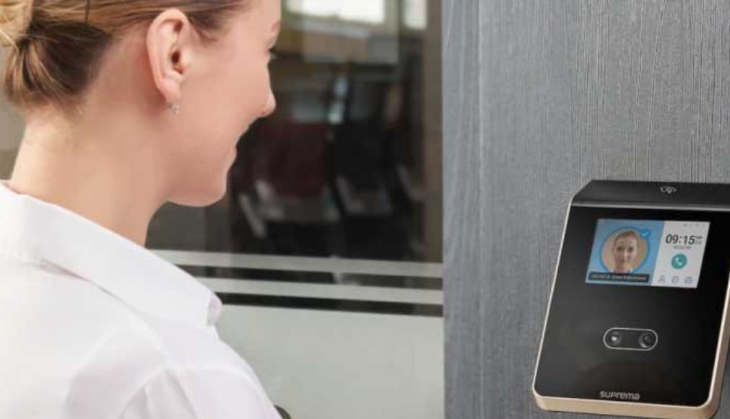
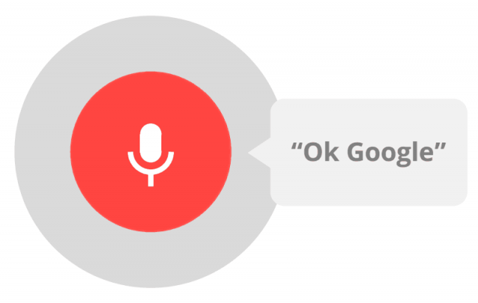

Slide 38

Can you find any examples/ideas of technology that might be replaced by touchless technology?
QUIZ #4

Slide 39
AI-powered tools for business
AI-powered tools help in redefining business processing and functioning strategies with real-time updates. The researchers coupled hyper-automation with cognitive automation process for understanding business needs deeply. Content intelligent technologies, along with AI-supportive processes, will help the digital worker to get exceptional skills. These skills will help them to deal with natural language automation, judgement, creating context, reasoning, and offer data-related insights.
#9
AI-Powered Business Processing, Forecasting, and Analysis

Slide 40
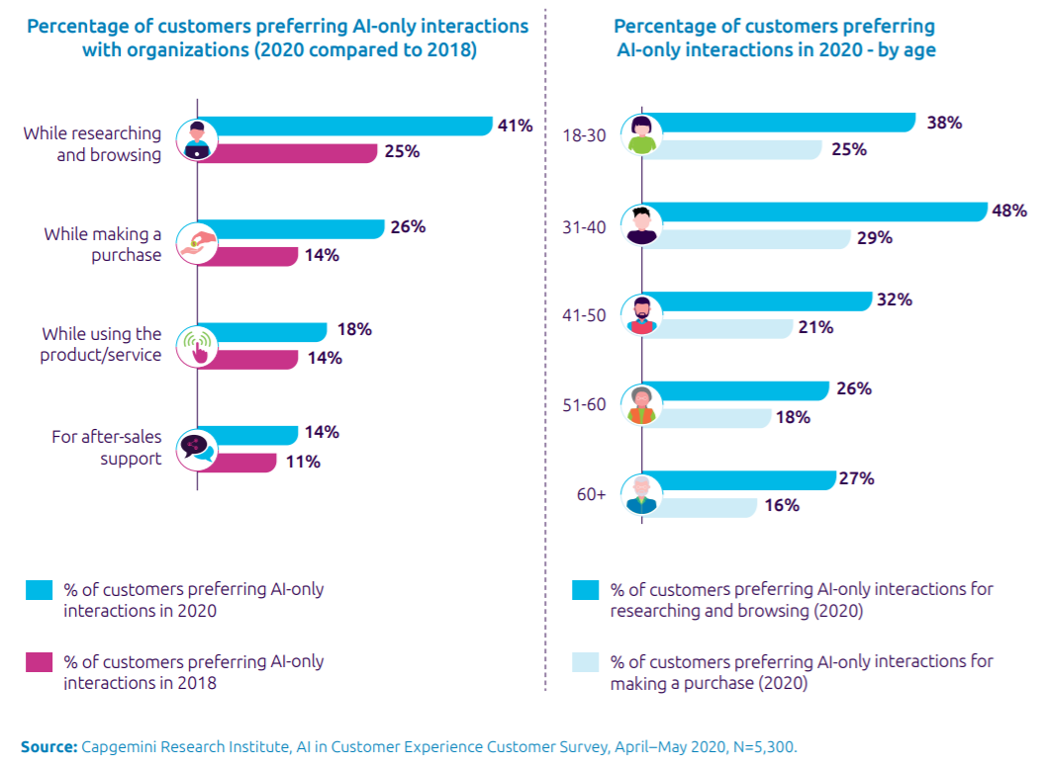

Slide 41
What is Quantum AI?
Quantum artificial intelligence (QAI) is an interdisciplinary field that focuses on building quantum algorithms for improving computational tasks within artificial intelligence, including sub-fields like machine learning (Wikipedia).
#10
Quantum AI

Slide 42

Quantum AI
Advanced businesses will start using quantum supremacy to quantify the Qubits for use in supercomputers. Quantum computers solve problems at a faster rate than classic computers do because of quantum bits. Moreover, they help in analyzing data and then predict several unique patterns.
https://quantumai.google/
https://ibm-q4ai.mybluemix.net/

Slide 43

In Your Opinion, will AI one day equal or surpass human intelligence? Should there be rules or laws limiting the development of AI?
QUIZ #5

Slide 44
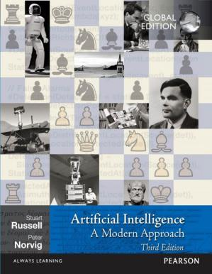
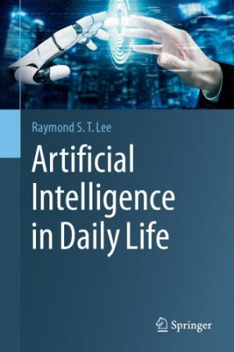
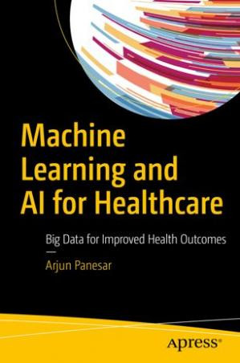

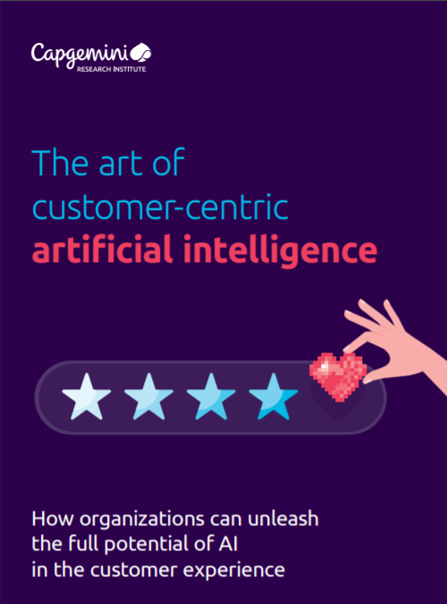
Books and References

Slide 45
References
https://thinkml.ai/top-10-ai-trends-to-watch-in-2021/
https://www.researchgate.net/figure/AN-OVerVieW-OF-NOTABLe-APPrOACHeS-AND-DiSCiPLiNeS-iN-Ai-AND-MACHiNe-LeArNiNg-101_fig5_316983844
https://www.abeam.com/id/en/service_line/RPA
https://www.latimes.com/science/sciencenow/la-sci-sn-wearable-sweat-sensor-20190128-story.html
https://www.ncbi.nlm.nih.gov/pmc/articles/PMC4455232/
https://towardsdatascience.com/ai-and-machine-learning-in-cyber-security-d6fbee480af0
https://www.mitre.org/sites/default/files/pdf/bloedorn_datamining.pdf
https://helloyubo.com/how-does-nlp-work-a-detailed-guide-to-make-an-nlp-pipeline/
https://deepsense.ai/what-is-reinforcement-learning-the-complete-guide/
https://ieeexplore.ieee.org/document/7539244
https://link.springer.com/article/10.1186/s40561-014-0004-5
https://link.springer.com/chapter/10.1007/978-3-642-37285-8_18
https://link.springer.com/article/10.1186/s40561-018-0052-3#Abs1
https://www.cam.ac.uk/research/news/ai-based-no-touch-touchscreen-could-reduce-risk-of-pathogen-spread-from-surfaces
https://www.capgemini.com/wp-content/uploads/2020/07/AI-in-CX_CRI-Report_16072020_V4.pdf
https://quantumai.google/

Slide 46

S1 Teknik Informatika
INGIN BELAJAR
Artificial Intelligence?
Peminatan:
Programming Expert
Cyber Security
Artificial Intelligence
S2 Ilmu Komputer
S3 Ilmu Komputer
Coming Soon… in 2021

Slide 47

TERIMA KASIH | SEMOGA BERMANFAAT

